Slide 1

Binary Segmentation of Medical Surgical Tool
Consent By:- Consent To :-
Rameshwar Singh Er. Urooj Khan
Data Science Trainer

Slide 2
Contents
Unet Architecture.
Preprocessing.
Dataset.
Code Snippets.
Outputs.

Slide 3
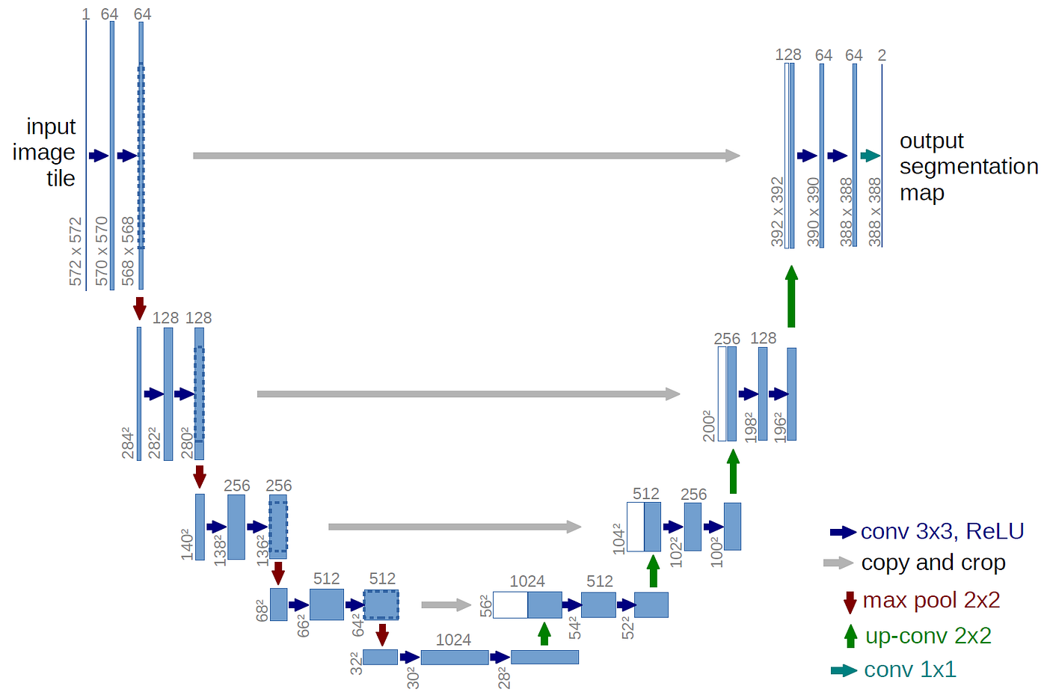
Unet Architecture

Slide 4
U-Net is a convolutional neural network (CNN) architecture that was developed in 2015 for biomedical image segmentation.
It is a U-shaped encoder-decoder network architecture that consists of four encoder blocks and four decoder blocks.
The encoder network (contracting path) halves the spatial dimensions and doubles the number of filters at each encoder block.

Slide 5
Preprocessing.
Preprocessing Include application of Image Processing Techniques including
Image Acquisition, Image Enhancement, Image Filtering, Geometric Transformations, Colour Processing, Image Restoration, Morphological Operations, Feature Extraction over the Dataset.

Slide 6
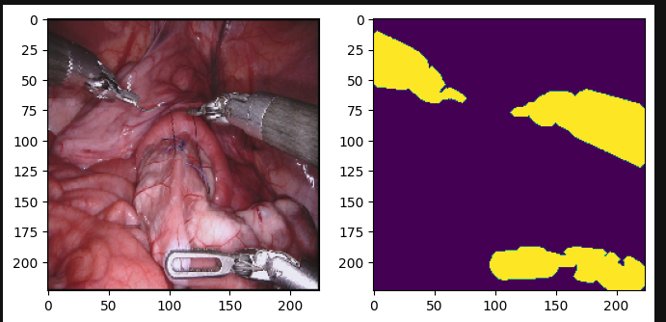
DATASET.
I have used 512 x 512 size of imaging tiles of Surgical Tool. With their Respected binary segmented map

Slide 7
model
def conv_block(tensor, nfilters, size=3, padding='same', initializer="he_normal"):
x = Conv2D(filters=nfilters, kernel_size=(size, size), padding=padding, kernel_initializer=initializer)(tensor)
x = BatchNormalization()(x)
x = Activation("relu")(x)
x = Conv2D(filters=nfilters, kernel_size=(size, size), padding=padding, kernel_initializer=initializer)(x)
x = BatchNormalization()(x)
x = Activation("relu")(x)
return x
def deconv_block(tensor, residual, nfilters, size=3, padding='same', strides=(2, 2)):
y = Conv2DTranspose(nfilters, kernel_size=(size, size), strides=strides, padding=padding)(tensor)
y = concatenate([y, residual], axis=3)
y = conv_block(y, nfilters)
return y

Slide 8
def Unet(h, w, filters):
# down
input_layer = Input(shape=(h, w, 3), name='image_input')
conv1 = conv_block(input_layer, nfilters=filters)
conv1_out = MaxPooling2D(pool_size=(2, 2))(conv1)
conv2 = conv_block(conv1_out, nfilters=filters*2)
conv2_out = MaxPooling2D(pool_size=(2, 2))(conv2)
conv3 = conv_block(conv2_out, nfilters=filters*4)
conv3_out = MaxPooling2D(pool_size=(2, 2))(conv3)
conv4 = conv_block(conv3_out, nfilters=filters*8)
conv4_out = MaxPooling2D(pool_size=(2, 2))(conv4)
conv4_out = Dropout(0.5)(conv4_out)
conv5 = conv_block(conv4_out, nfilters=filters*16)
conv5 = Dropout(0.5)(conv5)

Slide 9
deconv6 = deconv_block(conv5, residual=conv4, nfilters=filters*8)
deconv6 = Dropout(0.5)(deconv6)
deconv7 = deconv_block(deconv6, residual=conv3, nfilters=filters*4)
deconv7 = Dropout(0.5)(deconv7)
deconv8 = deconv_block(deconv7, residual=conv2, nfilters=filters*2)
deconv9 = deconv_block(deconv8, residual=conv1, nfilters=filters)
output_layer = Conv2D(filters=1, kernel_size=(1, 1), activation='sigmoid')(deconv9)
# using sigmoid activation for binary classification
model = Model(inputs=input_layer, outputs=output_layer, name='Unet')
return model

Slide 10
def jaccard_distance_loss(y_true, y_pred,smooth = 100): intersection = K.sum(K.abs(y_true * y_pred), axis=-1) sum_ = K.sum(K.abs(y_true) + K.abs(y_pred), axis=-1) jac = (intersection + smooth) / (sum_ - intersection + smooth) return (1 - jac) * smooth
def dice_coef(y_true, y_pred): y_true_f = K.flatten(y_true) y_pred_f = K.flatten(y_pred) intersection = K.sum(y_true_f * y_pred_f) return (2. * intersection + K.epsilon()) / (K.sum(y_true_f) + K.sum(y_pred_f) + K.epsilon())

Slide 11
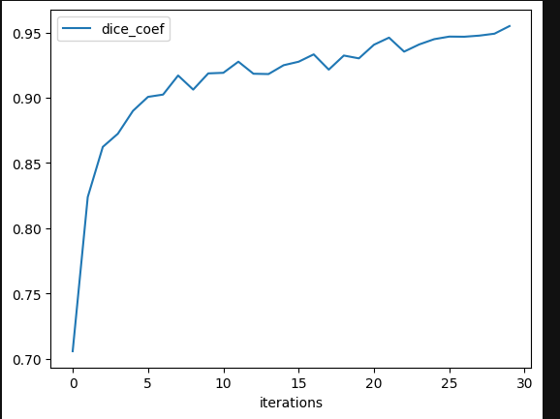
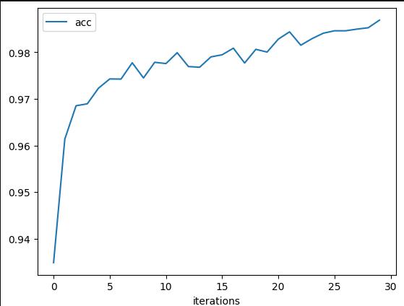
Dice_coef & Accuracy

Slide 12
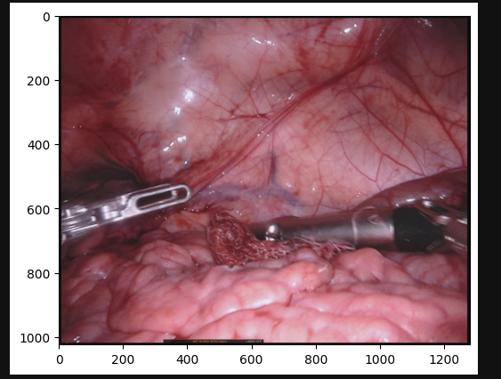
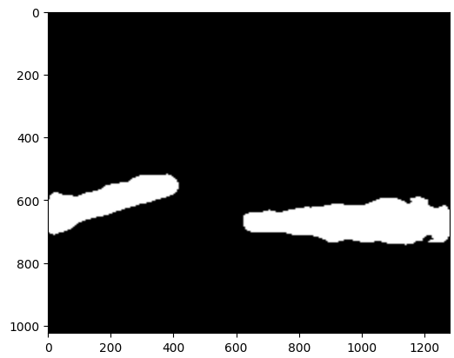
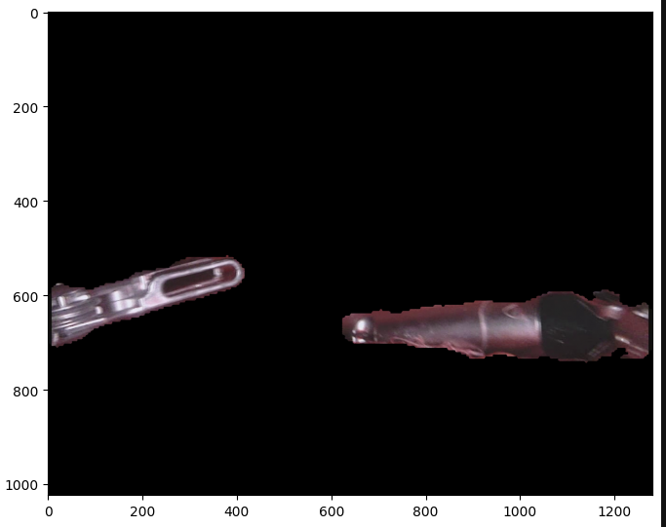

Slide 13
THANK YOU

